Slide 1
Altera’s SoC Devices & Development Tools

Slide 2






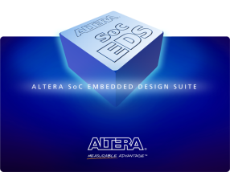

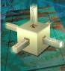

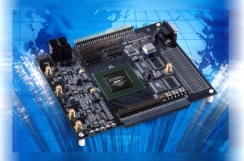

A Complete Solutions Portfolio
Lowest Cost, Lowest Power
CPLDs
Lowest Cost,
Lowest Power FPGA
Cost- and Power-Optimized FPGA
Highest Bandwidth
FPGA
Lowest Risk, Lowest Total Cost
ASICs
MIPS Technology
Embedded Hard & Soft Processors
& Development Suites
Intellectual Property (IP)
FPGA
Design
Software
Development
Kits
Notes:
Note that our product strategy is more than just about the silicon. Productivity oriented development tools, IP and development kits are key to Altera’s ability to make customers successful.

Slide 3
SoC System Architecture
Hard Processor System (HPS)
Processor
Dual-core ARM® Cortex™-A9 MP Core™ processor
4,000 MIPS (up to 800 MHz per core)
NEON coprocessor with double-precision FPU
Rich set of embedded peripherals
32-KB/32-KB L1 caches per core
512-KB shared L2 cache
Multiport SDRAM controller
Up to 533-MHz DDR3 and LPDDR2*
Up to 400-MHz DDR2
Integrated ECC support
Cache coherency between ARM & FPGA IP
High-bandwidth on-chip interfaces
> 125-Gbps HPS-to-FPGA interface
> 125-Gbps FPGA-to-SDRAM interface
ARM Cortex-A9
NEON / FPU
L1 Cache
ARM Cortex-A9
NEON / FPU
L1 Cache
USB OTG (x2) ⁽¹⁾
Ethernet
(x2) ⁽¹⁾
L2 Cache
GPIO
I²C
(x2)
(x4)
QSPI Flash Control
64-KB
RAM
JTAG Debug / Trace ⁽¹⁾
HPS I/Os
SPI
(x2)
CAN
(x2)
(x4)
NAND
Flash
⁽¹⁾ ⁽²⁾
SD / SDIO/ MMC ⁽¹⁾
Timers
(x11)
DMA
(8 Channels)
UART
(x2)
Shared Multiport DDR SDRAM Controller ⁽²⁾
HPS to
FPGA
FPGA
to HPS
FPGA
Configuration
FPGA
28LP process
8-input ALMs
Variable-precision DSP
M10K memory and 640-bit MLABs
fPLLs
FPGA General Purpose I/Os
Hard Multiport DDR SDRAM Controller ⁽²⁾
Hard
PCIe
3-, 5-, 6-, and 10-Gbps Transceivers
Multiport DDR SDRAM Controller
PCIe
Multiport DDR SDRAM Controller
Notes:
Integrated direct memory access (DMA)
Integrated ECC
* LPDDR2 support coming
Notes:
Here’s a more detailed block diagram of the SoC FPGA. The portion in blue is the HPS, and it contains the dual-core processor, each CPU with its own floating-point unit, NEON coprocessor, and L1 caches. The processors share a 512-KB L2 cache and a rich set of peripherals, including two triple-speed Ethernet ports, two USB on-the-go ports, interfaces to flash memory, general-purpose embedded peripherals such as UART, SPI, CAN, and I²C, and a shared multiport DRAM controller that supports DDR2, DDR3, and later in the year LPDDR2 – all with ECC.
Two high-bandwidth interfaces connect the HPS and FPGA fabric, with a third interface dedicated to low latency traffic from the processor to the FPGA. The processor has direct access to the FPGA configuration controller so it can configure the FPGA under program control.
The green portion represents the FPGA fabric and the grey blocks represent additional hard IP functions available to your custom logic, including additional multi-port DRM controllers, PCIExpress ports, and high-speed serial transceivers.
The HPS and FPGA have their own dedicated I/O and can are share some I/O functions when necessary. More on that later.

Slide 4

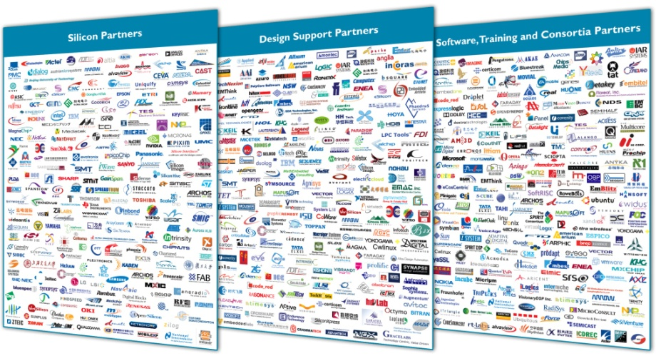
SoC Software Development Tools
Software Development Tools
Altera’s SoC Embedded Development Suite (EDS)
GNU Tools, Utilities, Libraries
ARM Design Studio 5 (DS-5)
Altera – Exclusive FPGA Adaptive
Lauterbach TRACE32
Wind River Workbench
ENEA Optima
Notes:
You can work with the same tools you already know, today on the Virtual Target, later on the physical device.
We plan to support all the major operating systems on our device. Several are already available on the Virtual Target today. More will be available with time.
For more information on the Virtual Target and how to get started on software development today, contact your Altera sales representative.

Slide 5






Embedded SW Availability
Vendor | OS/RTOS | Development Tools | Availability
Open Source | Linux 3.7 | Linaro compiler | Now through Altera
Wind River Systems | VxWorks 6.9.2 | Workbench 3.3.2 | Q2 2013 (beta now)
Micriµm | µC/OS-II, µC/OS-III | GNU compiler | Q2 2013 (beta now)
Enea | OSE 5.5.3 | Optima 2.6 | Q2 2013 (beta now)
Express Logic | ThreadX 5.5.3 | GNU compiler | Q2 2013 (June)
Wind River Systems | Wind River Linux 5 | Workbench/GNU | Q2 2013 (June-Wind River EAR)
QNX | QNX/Neutrino 6.5.3 | Momentics | Q3 2013 (July)
Fujisoft | Android | GNU compiler | Q2 2013 (June)
Green Hills | INTEGRITY | Multi/Green Hills | Q3 2013 (July)
Microsoft | Windows Embedded 7 | Microsoft/Studio | Q3 2013 (August)

Slide 6
Arrow’s SoCkit Overview

Slide 7
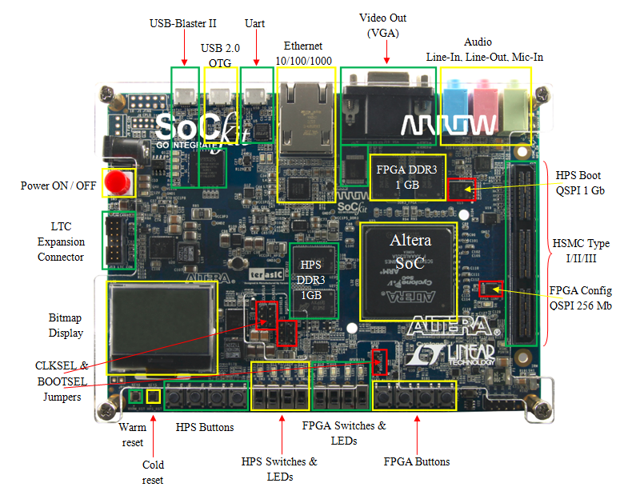
Arrow’s SoCkit Development Board
Based on:
Cyclone V SoC FPGA

Slide 8

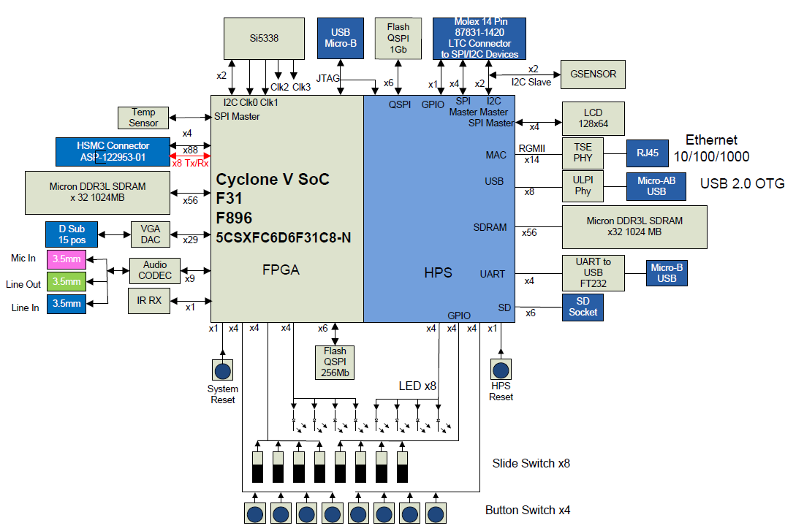

Arrow Cyclone V SoCKit
Button Switch x8

Slide 9
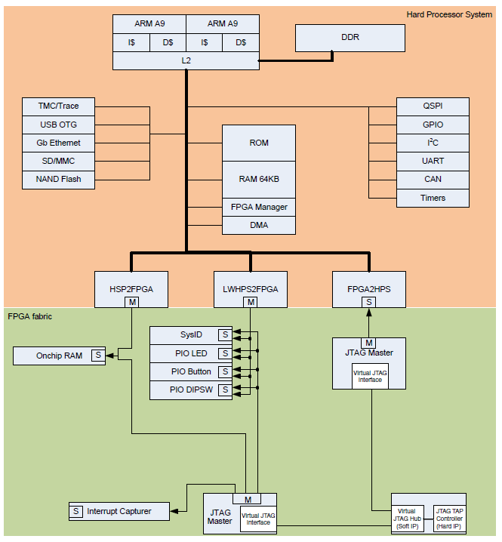
Golden Reference Design
HPS configuration
DRAM, QSPI, SD/Card
All peripheral functions exposed at least once
FPGA configuration
Simple Qsys “sandbox” system
First experience in ARM / FPGA integration
Getting started guide to walk them through the process on integrating IP
HW simulation
Verification via system console
Verification via CPU
HW/SW hand-off

Slide 10
Arrow’s SoCkit Dev Board – HW Features
Cyclone V SOC FPGA
Compact Board Size: ~15x10 cm (6” x 4”)
ARM Cortex-A9 based Hard Processor System (HPS)
Full set of peripherals (Flash I/F’s, GbE, USB, SD, SPI, I2C, CAN, UARTs, DMA’s, Timers…)
Two independent banks of DDR3: 4GB (x32) @ 533MHz
GbE Ethernet
USB 2.0
OTG
UART to USB
SD Card Socket (Support 4-bit SD mode)
Display
24-bits RGB VGA
Graphic LCD: 128x64
Notes:
Drivers for all HPS peripherals available and included. Drivers for VGA, audio and sensors posted soon.

Slide 11
Arrow’s SoCkit Dev Board – HW Features (2)
General Peripheral: LEDs / Buttons / Switches / IR
Audio CODEC: Line-In, Line-Out, Mic-In
Temperature Sensor
G-Sensor
On-Board USB-Blaster II (Config/Debug cable interface)
Expansion Headers
HPS IP: LTC (Linear Tech) Header
FPGA fabric: High Speed Mezzanine Connector (HSMC) including transceivers
Note: For Mictor Dstream connectors – see the Altera SoC Dev kit

Slide 12
Altera’s SoC Embedded Design Suite (SoC EDS)

Slide 13
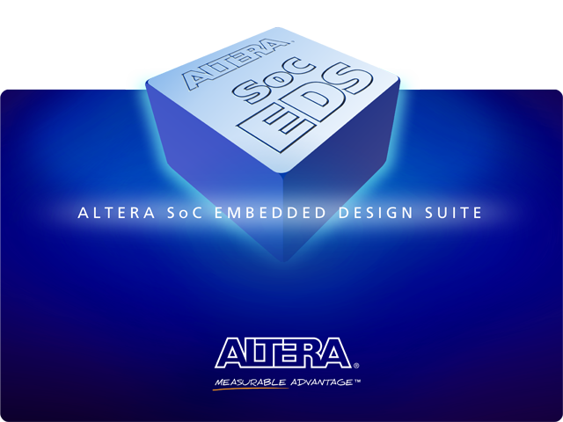
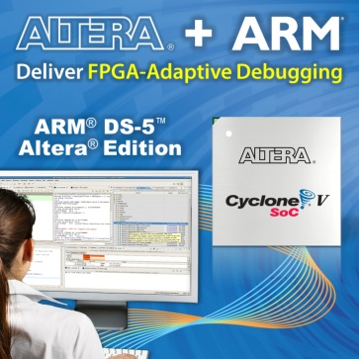
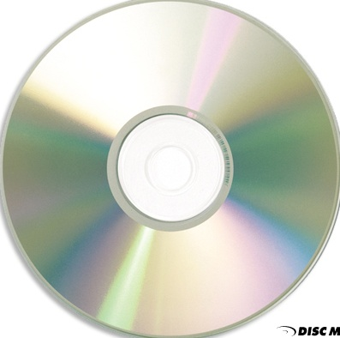


Altera SoC Embedded Design Suite
Comprehensive Suite of SW Dev Tools:
Hardware / Software Handoff Tools
Preloader Generator: Parameterizes files for Preloader/BSP
Device Tree Builder (Linux) (13.0 SP1)
Driver Development, Board Bring-up
Bare-metal application development
SoC Hardware Libraries
Bare-metal compiler tools
FPGA-adaptive debugging
ARM DS-5 Altera Edition Toolkit
Seamless FPGA peripheral visibility
Linux application development
Yocto Linux build environment
Pre-built binaries for Linux / U-Boot
Work in conjunction with the Community Portal
Design examples
Altera
Exclusive
SoC EDS
Unprecedented Visibility and Debug Capability!

Slide 14
SoC EDS Contents
Component | Key Feature | Web Edition | Subscription Edition | 30-Day Evaluation
Hardware/Software Handoff Tools | Preloader Image Generator | x | x | x
 | Flash Image Creator | x | x | x
 | Device Tree Generator (Linux) | x | x | x
ARM DS-5 Altera Edition | Eclipse IDE | x | x | x
 | Debugging over Ethernet (Linux) | x | x | x
 | Debugging over USB-Blaster II JTAG |  | x | x
 | Automatic FPGA Register Views |  | x | x
 | Hardware Cross-triggering |  | x | x
 | CPU/FPGA Event Correlation |  | x | x
Compilers | Linaro Tool Chain (Linux) | x | x | x
 | CodeBench Lite EABI (Bare-metal) | x | x | x
Hardware Libraries | Bare-metal programming Support | x | x | x
SoC Programming Examples | Golden System Reference Design | x | x | x
* Not available in 13.0

Slide 15
Altera SoC EDS Additional Deliverables
Golden Hardware Reference Design (GHRD)
Pre-built: Linux Kernel, Root FileSystem, U-Boot
Pre-built with full source (Linux snapshot)
Link to community website for updates
Software Example Designs:
Hello World Bare metal (GNU)
Hello World Bare metal (armcc)
Hello World for Application Linux
Linux simple device driver example design
Linux Web Server simple driver
Notes:
We will discuss these as we go through the presentation

Slide 16
Software Process: HPS Boot Stages
Boot ROM code
Hardened by Altera into device.
Scans boot select pins to determine clocks/boot source
- NAND, QSPI, SD/MMC, FPGA or On-chip RAM
Sets up PLL’s if selected by clock pins
Configure minimal set of HPS I/O pins to read flash
Performs CRC checking & loads ISW into On-Chip RAM
Reset
SW / FW
Developer’s
efforts
Boot ROM
PreLoader (Initial Software)
Altera Reference code + generated system .c & .h files
Runs from On-Chip memory
Configures scan manager with pin configuration data
Initializes and calibrates SDRAM
Loads Boot Loader code into SDRAM
PreLoader
Boot Loader
Boot Loader
Application / OS specific
Altera provides U-Boot as a reference example
OS
Operating System
Linux, VxWorks, OSE, etc
Device drivers and BSP
Root FileSystem
Application
User Application
IDE and Debug
FPGA configuration

Slide 17
Hardware-Software Handoff: PreLoader Generator
Generates & Parameterizes files for making the PreLoader / BSP
Reset
Hard coded in HPS
Boot ROM
PreLoader “Initial Software (ISW)” or
“Secondary Program Loader (SPL)”
Low level hardware-centric source code
Runs from On-Chip memory
Configures scan manager with pin configuration data
Initializes and calibrates SDRAM
Loads Boot Loader code into SDRAM
PreLoader
Boot Loader
OS
uBoot - common bootloader – popular for Linux
Application

Slide 18
SoC Boot Phases to Bare-metal or OS
Recommended Flow
Typical OS
Boot Process
Boot
ROM
Preloader
Bootloader
OS
Application
Bare-Metal Application
Boot
ROM
Preloader
Bootloader
Bare-Metal Application
Bare-Metal Application
Boot
ROM
Preloader
Bare-Metal Application
Bare-Metal Preloader Replacement
Boot
ROM
Bare-Metal Application
Boot ROM | Preloader | Bootloader | OS | Apps
Boot Phase
Notes:
Complex Application processors like the Cortex-A9 are designed to run with Operating systems. Altera does offer libraries and a generic configuration for Bare-metal development, but with 100’s of registers in the core, custom bare-metal designs are discouraged.

Slide 19
HW Libraries & OS/Bare-Metal Development
Bare-metal
No Operating System
User code and hardware libraries/drivers
Hardware Libraries
Software interface to all system registers
Functions to configure some basic system operations (e.g. clock speed settings, cache settings, FPGA configuration, etc.)
Support board bring-up and diagnostics
Can be used by bare-metal application, device drivers, or RTOS
GNU-based bare-metal (EABI) compiler tools
Bare-metal App
Application
Bare-metal App
Operating System
BSP
Hardware Libraries
HWLIB
HPS

Slide 20
APIs in HWLIB (Bare-metal)
Phase 1
Phase 2
(V13.1)
MPU Subsystem
Timers
Test Support Mgmt
UART
Cache Mgmt
Memory Map Cntl
Watchdog
ECC/Parity Error
UART
Address Filters
General Purpose
Basic Mem Tests
JTAG UART
Mem Coherence
Bridge Management
Flash Memory Intrf
FPGA Manager
FPGA2HPS
QSPI
MMU Mgmt
Full Configuration
HPS2FPGA
NAND
Interrupt Ctrl
Partial Reconfig
LWHPS2FPGA
SD/MMC
Pin I/O Cnf Mgmt
Clock Manager
System Manager
GPIO
ECC Mgmt
Reset Manager
SDRAM Ctrl
DMA
Parity Mgmt
SoCAL Layer (non ARM IP)
SoCAL Layer (ARM IP)
Notes:
Supports MPU Subsystem
Caches
MMU
Interrupt Ctlr
ACP/SCU
Support Peripherals:
Bridges (Axi, etc.)
Clock Mgr
FPGA Mgr
Reset Mgr
System MGR
Timers/GPT/WDT
DMA
Interface Peripherals:
Pin I/O Cfg
GPIO
Flash Memory
SDRAM Ctlr
Cache management
UART
Also example tests (example code to test out peripherals)

Slide 21
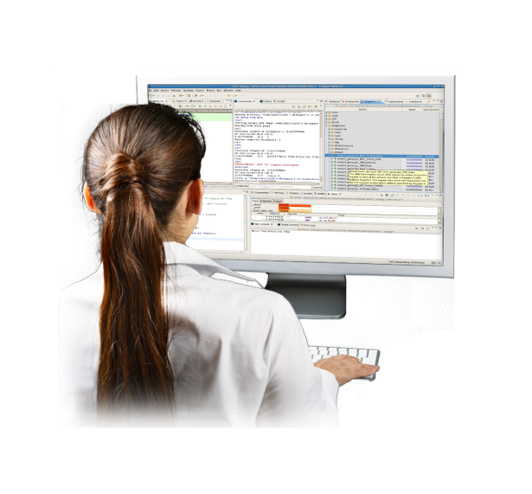
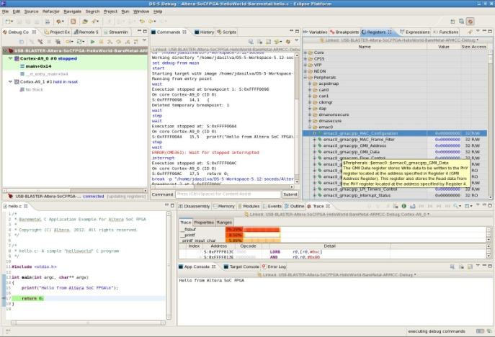
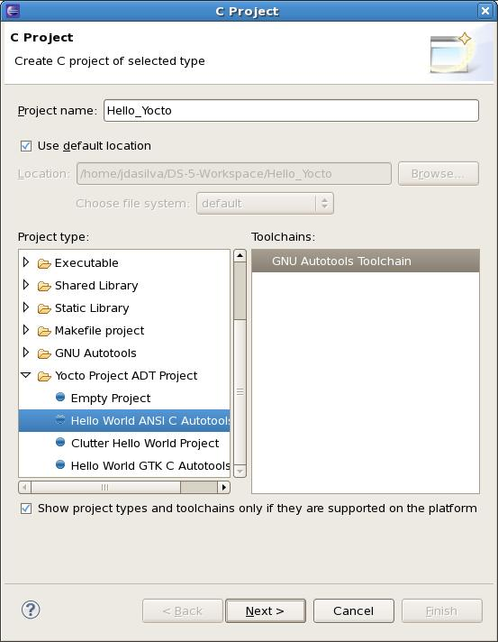
SoC EDS Includes ARM DS-5 Altera Edition
Industry’s most advanced multicore debugger from ARM for ARM processors
Supports JTAG/Ethernet/Trace debug in one package
Trace pod – Dstream – 4Gbyte trace memory
True dual core/debugger capability
Streamline: Statistical analysis of software load and bus traffic spanning the CPUs and FPGA under Linux
Integrated OS-aware analysis and debug capability
Yocto plugin to enable Linux based application development
Notes:
ARM: This slide illustrates that the Altera Edition has all the functionality of ARM’s DS-5 debugger. DS-5 is already a powerful debugger, and there are no limitations at all for Altera Edition, except that it only works for Altera devices. Gives customers all the visibility into the design needed for the job. For example, engineers will benefit from the industry’s most advanced multicore debugger for ARM, can run Linux, can see processor mode, and get all the functionality they would get from an expensive debugger.
The screenshot at the back shows the graphical user interface of DS-5 Debugger.
The screenshot on top shows the Eclipse “New C Project” dialog when the Yocto Eclipse plug-in is installed. The Yocto plug-in enables you to more easily create Linux projects for a hardware target with changing peripherals. This is discussed later in the Linux flow section.

Slide 22

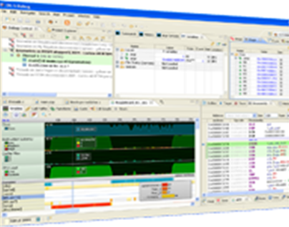
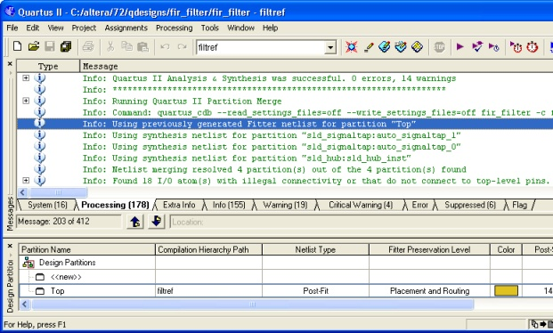
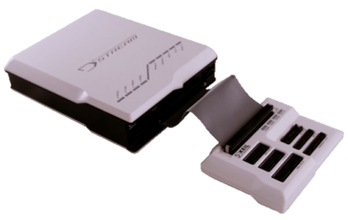
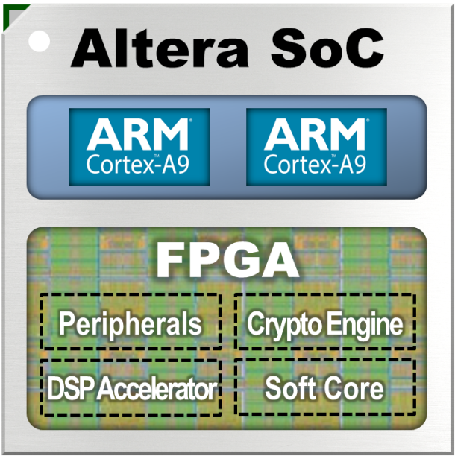
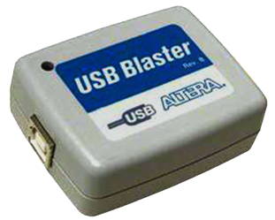
One Device, Two Debugging Tools?
ARM® DS-5™ Toolkit
Altera Quartus™ II Software
JTAG
DSTREAM™
Dedicated JTAG connection
Visualize & control CPU subsystem
JTAG
Dedicated JTAG connection
Visualize & control FPGA
Notes:
Altera to present

Slide 23
One Device, Two Debugging Tools?
ARM® DS-5™ Toolkit
Altera Quartus™ II Software
Debugging Barrier
No single tool/cable to visualize and control both CPU and FPGA domains
No way for CPU and FPGA to cross trigger and correlate hardware and software events
No “fixed” debugger can address the needs of “changing” FPGA hardware
JTAG
DSTREAM™
Dedicated JTAG connection
Visualize & control CPU subsystem
JTAG
Dedicated JTAG connection
Visualize & control FPGA
Notes:
Altera to present

Slide 24
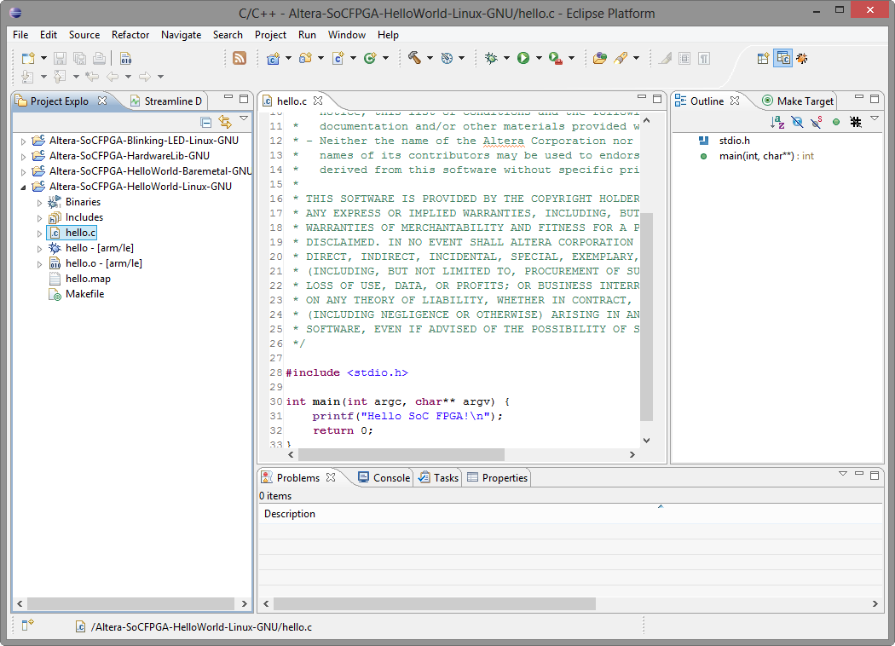
Familiar Eclipse Framework
Select Perspective
File Viewer
Outline View
(View functions, enums, classes, structs etc.)
Projects
Terminal Window

Slide 25
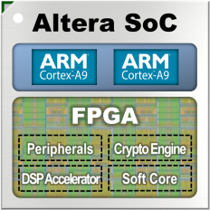
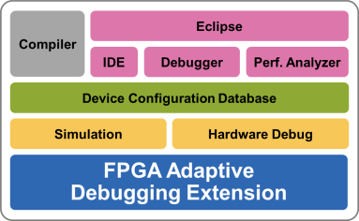
DS-5 Altera Edition Productivity-Boosting Features
Single USB-Blaster target connection for software and hardware debug
Automatic creation of register views of FPGA peripherals
Hardware cross-triggering between the CPU and FPGA domains
Non-intrusive trace of CPU software instructions correlated with application events and FPGA hardware events
Simultaneous debug and trace for Cortex-A9 cores AND cores synthesized on FPGA*
Streamline support: Statistical analysis of software load and bus traffic spanning the CPUs and FPGA
ONLY SoC Technology… Altera’s SoC’s can achieve this
* For CoreSight™ -compliant cores: IP added using proper handoff files (CMSIS)
Notes:
Altera’s SoC Technology is the only one with the combination of silicon and SW Debugger features capable of cross triggering between HW and SW domains.
That is: A HW event and trigger causing a simultaneous SW trace trigger – and vice versa – a SW event and trigger initiating SW trace and simultaneously triggering hardware trigger & capture.

Slide 26
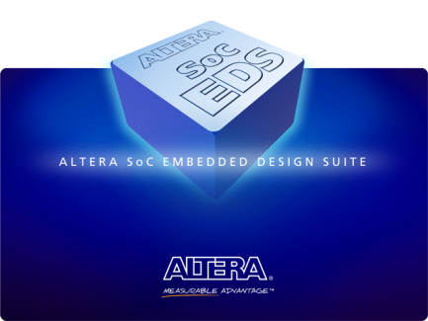
Altera SoC EDS - Key Benefits
Faster time to market, lower development costs
Covers full software development flow for Altera SoC devices
All necessary tools and examples in one package to enable rapid start for developers
Provides software debug views of full SoC by adapting to changing FPGA designs (Subscription)
Unprecedented visibility and control across processor cores and across CPU, FPGA domains
OEM packing ensures ease of licensing and ease of use

Slide 27
Software Debug & Trace Interfaces & Tools

Slide 28
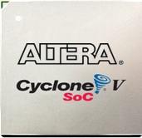
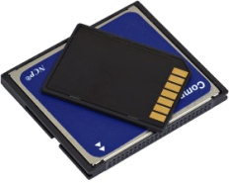
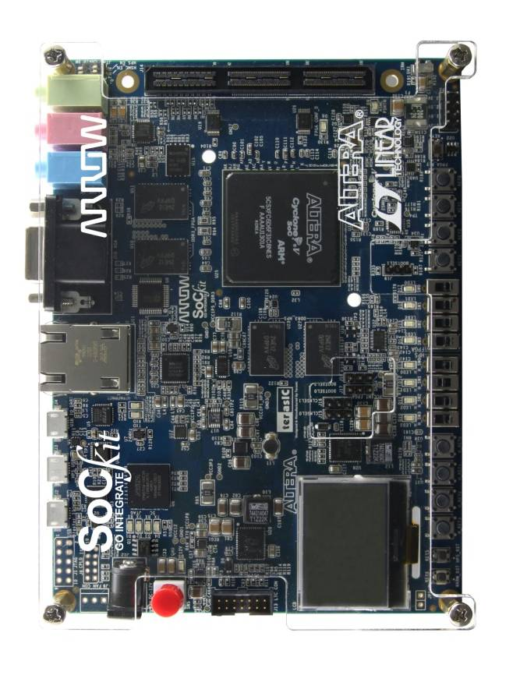

Interfaces for SW Developers
Flash / QSPI / SD
SW tools
Host Machine
Ethernet
Bottom side
SD
Trace
Today’s workshop
JTAG via USB
JTAG

Slide 29
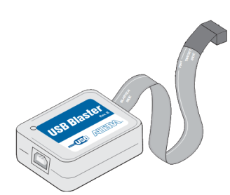
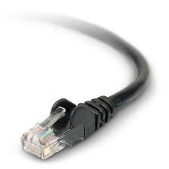
Software Debug Interfaces
JTAG
Direct connection to hardware
Halts processor, can master system via control of processor
Debug any code at low level – driver, OS kernel, bare metal application
OS aware debugger display optional
Note: Other debuggers require 2 debugger interfaces for dual-core processors
Ethernet
Requires running software to drive it
Processor/OS cannot be halted
OS Application can be halted
Good for high level programming (fast, easy)
Debuggers usually have OS aware GUIs and features
Cannot do low level debug (kernel, driver, bare metal) as OS cannot be stopped

Slide 30
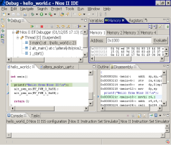

Real-Time Trace (JTAG/Ethernet/USB)
Processor ‘data logger’ system
Runs at full speed to identify and debug real-time software issues
Hardware triggers on predefined condition
Address value, data value or a combination
Stores instruction or data flow information to on-chip or off-chip memory for analysis in debugger
Trace Capable Debugger
Host
Display
High-speed Connection
(i.e. Mictor conn)
Trace Pod with on-board memory
Processor
Ethernet or USB
Processor
Trace HW
JTAG/USB/Ethernet

Slide 31
SoC Development Flow Software Design Flow – Part 1: Preloader and Bare metal

Slide 32
Software Perspective
Application
Software Engineer
Driver
HWLib
SoCAL (Lib)
App
OS
BSP
Registers
Silicon Device
Middle
Ware
IP Cores
Application
Middleware
Hardware abstraction
Firmware
Software Engineer
Notes:
Primary focus of the Apps and Firmware Developers

Slide 33

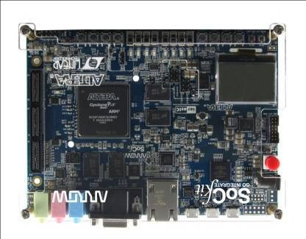
System Development Flow
FPGA Design Flow
Software Design Flow
Hardware
Development
Software
Development
Quartus II design software
Qsys system integration tool
Standard RTL flow
Altera and partner IP
Design
Design
ARM Development Studio 5
GNU toolchain
OS/BSP: Linux, VxWorks
Hardware Libraries
Design Examples
ModelSim, VCS, NCSim, etc.
AMBA-AXI and Avalon bus functional models (BFMs)
Simulate
Simulate
Virtual Target
SignalTap™ II logic analyzer
System Console
Debug
Debug
GNU, Lauterbach, DS5
Quartus II Programmer
In-system Update
Release
Release
Flash Programmer

Slide 34
System Development Flow
FPGA Design Flow
Software Design Flow
Hardware
Development
Software
Development
Design
Design
Software Development
Quartus II design software
Qsys system integration tool
Standard RTL flow
Altera and partner IP
HW/SW Handoff
ARM Development Studio 5
GNU toolchain
OS/BSP: Linux, VxWorks
Hardware Libraries
Design Examples
ModelSim,etc.
AMBA-AXI and Avalon bus functional models (BFMs)
Simulate
Simulate
Virtual Target
SignalTap™ II logic analyzer
System Console
Debug
Debug
GNU, Lauterbach, DS5
Quartus II Programmer
In-system Update
Release
Release
Flash Programmer

Slide 35

Quick Summary
FPGA:
Looks like a FPGA
Works like a FPGA
Standard FPGA development flow
Quartus II, Qsys, SignalTap, System Console, USB blaster...
ARM HPS:
Looks like an ARM processor system
Works like an ARM processor system
Standard ARM development flow
ARM Cortex-A9 compiler/debugger, JTAG tools, program trace...
Back

Slide 36
Software Process: HPS Boot Stages
Boot ROM code
Hardened by Altera into device.
Scans boot select pins to determine clocks/boot source
- NAND, QSPI, SD/MMC, FPGA or On-chip RAM
Sets up PLL’s if selected by clock pins
Configure minimal set of HPS I/O pins to read flash
Performs CRC checking & loads ISW into On-Chip RAM
Reset
SW / FW
Developer’s
efforts
Boot ROM
PreLoader (Initial Software)
Altera Reference code + generated system .c & .h files
Runs from On-Chip memory
Configures scan manager with pin configuration data
Initializes and calibrates SDRAM
Loads Boot Loader code into SDRAM
PreLoader
Boot Loader
Boot Loader
Application / OS specific
Altera provides U-Boot as a reference example
OS
Operating System
Linux, VxWorks, OSE, etc
Device drivers and BSP
Root FileSystem
Application
User Application
IDE and Debug
FPGA configuration

Slide 37

Hardware / Software Handoff Tools
Allows hardware and software teams to work ‘independently’ and follow their familiar design flows
Altera Quartus II / Qsys handoff output files converted into files for the software design flow
Device Tree standard specifies hardware configuration/peripherals so that Linux kernel can boot up correctly

Slide 38

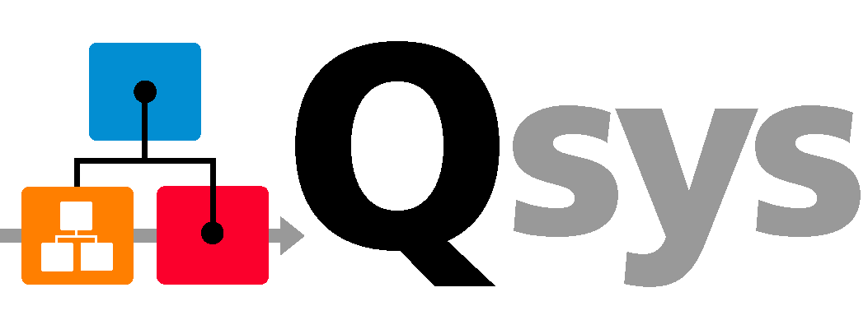
Hardware / Software Handoff
Qsys system info, SDRAM calibration files, ID / timestamp, HPS IOCSR data
Hardware
ISW_handoff.sys
system.sopcinfo
Preloader Generator
Device Tree Generator
User Options
.c & .h
source files
Linux
Device Tree
Software

Slide 39


Hardware/Software Design Flow Overview
PreLoader
Settings
Directory
Handoff
files
ACDS
Handoff
Preloader Generator
Preloader
HW Design
.svd
DS-5 Debugger
.sopcinfo
DeviceTree
Generator
Device Tree
For
Linux
SoC EDS
.sof
Notes:
Another perspective showing how the SoC EDS ties into the handoff process – including the DS-5 debugger.
Note: Device Tree not supported until 13.0 sp1
.svd file gives shows description of soft IP peripheral registers in FPGA . Located in <hps_qsys_project> directory.
.sopcinfo file is the output of Qsys

Slide 40
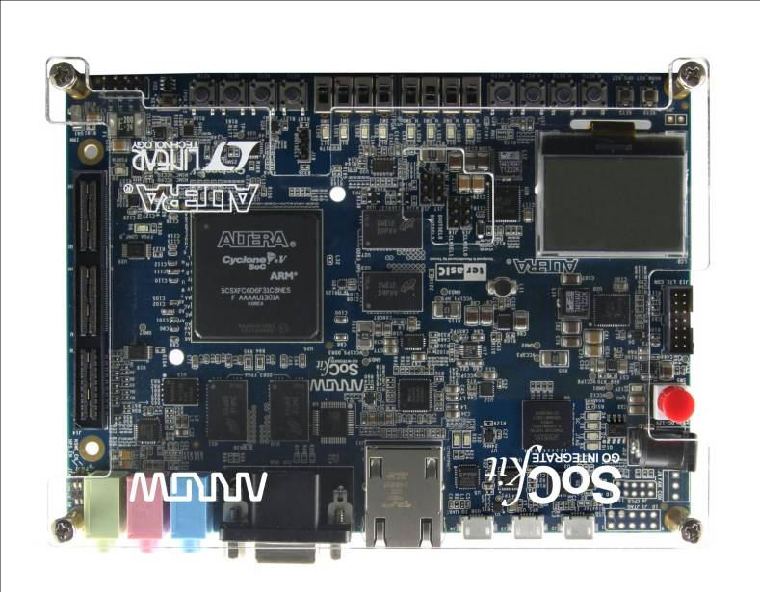
Hardware/Software Design Flow Overview
Eclipse/GCC/GDB Software Design Flow
Hardware
Development
Software
Development
Open New BSP Project
Import HW/SW Handoff Files
HW/SW Handoff files
Preloader
Generator
Enter User Settings
Build
Flash Programmer
SOF/POF
Software Image
Flash Image builder
Notes:
High level view of the flows and handoff including flash programming

Slide 41
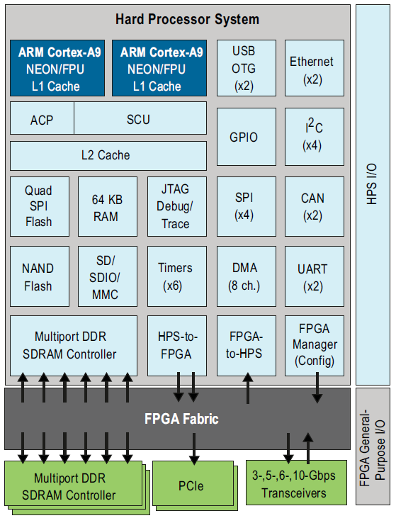
Design Areas on SoC FPGA Devices
Processor System
The domain of software engineers
Problem areas
Identification of HW issues at runtime
Working across SW & HW domains
Coherent real-time HW/SW debug
Drivers for new or changing hardware
System-level performance analysis
FPGA Fabric
The domain of hardware engineers
Notes:
ARM’s DS-5, Altera Edition is uniquely designed to work with Altera’s SoC debug features to give unprecedented visibility and power to overcome classic System-On-Chip debug problem areas.

Slide 42
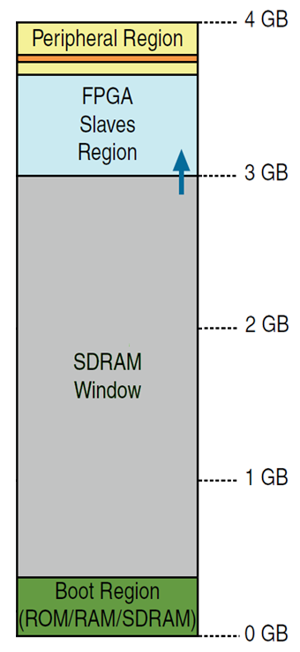

Altera SoC FPGA Based Peripherals
FPGA
FPGA IP mapped
To 3GB and above
MEMORY MAP
FPGA IP
32/64/128-bit AXI Bridges plus
Lightweight Bridge
32-bit
AXI
AXI
AXI (LW)
L3 interconnect
L2 Cache
Cortex-A9
Cortex-A9
Cortex-A9 0-3(+)GB
memory space
HPS
Notes:
Altera SoCs are architected and designed to provide a superior performance, flexibility and visibility.
The Lightweight AXI bridge gives an alternate path for accessing registers while not interfering with the high performance AXI bridges. (i.e. have large DMA transfers in process).

Slide 43
Cortex-A9 Debug
Interactive Debug
Controlled via JTAG or CPU monitor code
6 HW Breakpoints, 2 with Context ID compare
4 HW Watchpoints
Performance Monitoring
Each A9 has a Performance Monitoring Unit (PMU)
Each PMU can monitor 58 different events
6 counters to count events
Events may be triggers or put in trace
See Cortex A9 TRM for additional details
Back

Slide 44
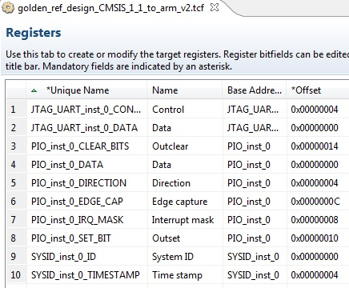
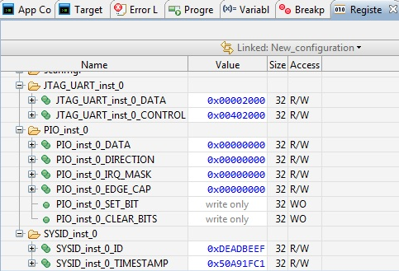
Visualization of SoC FPGA Peripherals – FPGA Adaptive
Register views assist the debug of FPGA peripherals
File generated by FPGA tool flow
Automatically imported in DS-5 Debugger
Changes dynamically
Debug views to debug software drivers
Self-documenting
Grouped by peripheral, register and bit-field
CMSIS
Peripheral register descriptions
Notes:
Ability to have visibility into FPGA peripherals is exclusive to Altera – through the FPGA Adaptive aspect of ARM’s Altera Edition of DS-5.
Note the CMSIS files coming from peripherals in Qsys allow the registers to be described (offsets, bits, etc).

Slide 45
Altera SoC Debug Architecture
STM: System trace module
PTM: Proc trace module
TPIU: Trace port I/F Unit
CTI: Cross trigger I/F
CTM: Cross trigger module
DAP: Debug Access Port
28 HW signal events
injected into trace stream
FPGA
FPGA IP
Cross-triggers between FPGA(8) and CPUs (8)
CPUs and CoreSight compatible IP implemented in FPGA logic
accessible from Debugger
Trace
SWD/
JTAG
CTI
DAP
Debug bus
System bus
TMC
ETR
STM
Trace bus
Export trace to trace port, peripheral or memory
CTM
PTM
PTM
Full trace capability on hardened part of the SoC
Ability to inject FPGA hardware debug data into
the CoreSight trace stream
Infrastructure to trace CPUs synthesized on the FPGA
TPIU
Mictor Connector
CTI
Cortex-A9
CTI
Cortex-A9
HPS
Notes:
Altera SoCs are architected and designed to provide a superior software debug experience.

Slide 46
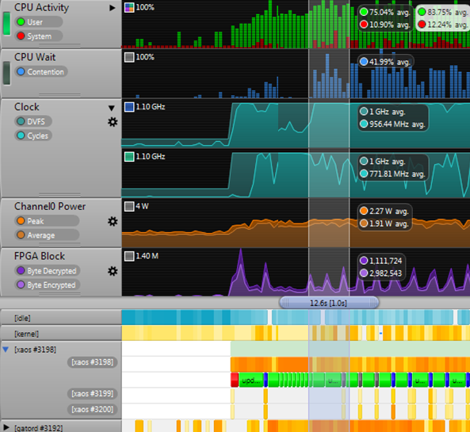
System-Level Performance Analysis
Performance bottlenecks in SoCs often come from the CPU interaction with the rest of the SoC
Streamline visualizes software activity with performance counters from the SoC and FPGA to enable full system-level analysis
Streamline only requires a TCP/IP connection to the SoC
ARM® DS-5™ Streamline
Linux OS Counters
Processor Counters, Aggregated, or Per Core
Power Consumption
FPGA Block Counters
Process/Thread Heat Map
Application Events

Slide 47
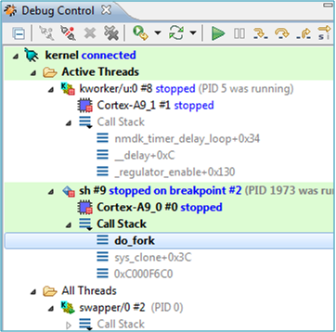
Synthesizing CPUs on FPGA
CPUs and CoreSight compatible IP synthesized on the FPGA are accessible via the Debug Access Port (DAP) and therefore detectable and debuggable by DS-5
DSP
IP
FPGA
SWD/
JTAG
Debug bus
Cortex-A9
DAP
Cortex-A9
HPS

Slide 48
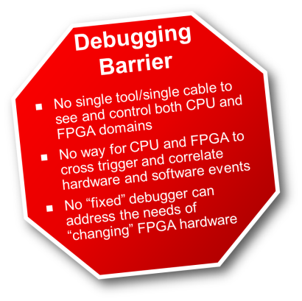
Key Benefits for Developers
Removes Debugging Barrier!
Faster time to market, lower development costs
Significant productivity gains
Provides software debug views of full SoC by adapting to changing FPGA designs
Unprecedented visibility and control across processor cores and across CPU, FPGA domains
Standard, widely used, familiar DS-5 user interface provides SW engineers with rapid starts
OEM packing ensures ease of licensing and ease of use
Notes:
ARM or ALTERA: The tool delivers engineering efficiency, having professional tools at minimum cost. These benefits apply to both software developers and to system developers to solve problems between the system and the fabric. This means lower costs, higher revenue for customers. For software users – they will get the same interface they love with all the features for software development. Great experience for software developer. DS-5 and Signal Tap – customers will get all the info they need to solve any problems.
We are delivering access to professional quality tools at an affordable price.

Slide 49
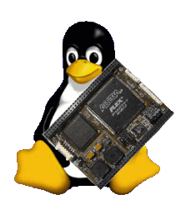
Embedded Linux for SoC Software Design Flow – Part 2

Slide 50
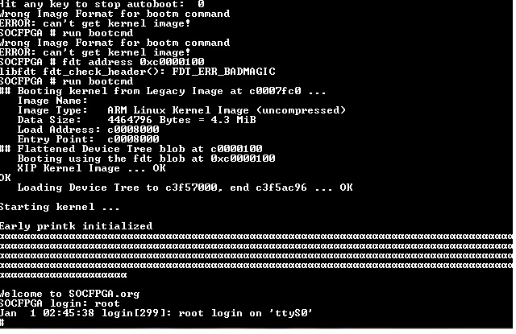
Getting to the familiar Linux Boot

Slide 51
SoC Linux: Key Takeaways
Linux & tools available for SoC
One of the first ARM multi-vendor platforms supported by a single Linux Kernel v3.7
Leverages new, efficient community methodology for generating custom Linux distributions - Yocto
Innovation on Device Tree to support “changing” hardware profile
Device Tree Generator (DTG), available v13.0 SP1
Community Portal to facilitate collaboration with developers
Kernel, U-Boot up-streamed and maintained
Notes:
For the Linux Gurus, you can appreciate how much has gone into the support and tools for SoC FPGA Linux – and for the Newbies, we will cover the key pieces that Altera’s Linux team has put together.
Note: Xilinx Zynq is not in the multi-vendor platforms list for v3.7

Slide 52
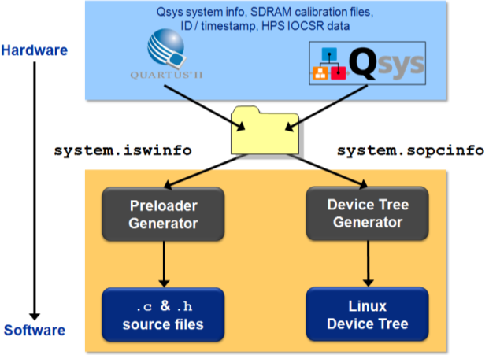
Linux for SoC: Innovative Approach
We discussed the low level hardware handoff:
Typically developers build Linux for fixed form chips
The SoC Challenge...
How do you build Linux for a chip that changes?
You use a “Device Tree Generator”, of course!

Slide 53
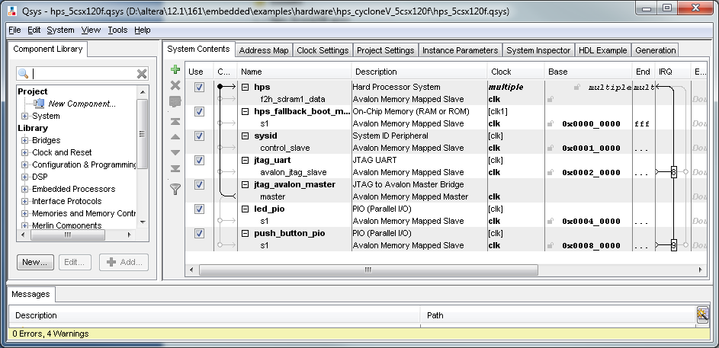
What’s a Linux Device Tree?
A Data Structure for describing hardware
Enables Device Drivers to be linked to Linux kernel at run-time
No Linux kernel recompile required
Drivers loaded dynamically after loading Device Tree
Device Tree embedded in FPGA memory, correct drivers are always loaded
Can carry additional system information

Slide 54
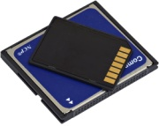
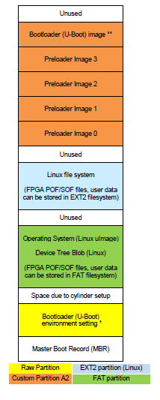
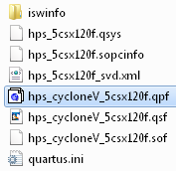
Device Tree Generator
Altera SoC
Embedded Design Suite
Directory
Device
Tree
Generator
DTS Compiler
Device Tree Source
Device Tree Blob
Board/User Info
Device Tree Generator Ships in Altera SoC Embedded Design Suite – in V13.0 SP1
SD/MMC

Slide 55
Why Use a Device Tree?
Single compiled kernel and set of drivers used on a number of boards
Key with FPGA’s where hardware is easily and frequently changed
Facilitates changing hardware on the fly
Dynamic Device Tree
Ability to update your FPGA/Device Tree Source without rebooting the kernel
Available soon

Slide 56
SoC Linux Board Support Package
U-Boot (not pictured)
Kernel
Drivers for SoC
Drivers for the board components
SoC specific layer
Source code for the root file system
Build environment
User Space
(debug, compiler, shell, applications etc)
Kernel
BSP
Drivers
Machine Specific Layer
SoC
Board
SoC Linux BSP release provides all of the components in source code form

Slide 57










What is Yocto?
As stated by the project page:
The Yocto Project™ is an open source collaboration project that
provides templates, tools and methods to help you create custom
Linux-based systems for embedded products regardless of the
hardware architecture.
Yocto is based on Open Embedded (OE)
Suite of tools (e.g. bitbake)
Leverages OE’s architecture
Recipes, layers
Makes sure the various components required by OE work together
Notes:
BitBake is a “make like” build tool with the special focus of distributions and packages for embedded Linux cross compilation to build source code

Slide 58

Benefits of Yocto Project
Less time spent on things which don’t add value (build system, core Linux components)
Increased ability to enable key silicon features
Transparent Upstream changes
Vibrant Developer Community
Start with a validated collection of software (tool chain, kernel, user space).
Easy transition to a commercial embedded Linux
"It’s not an embedded distribution
it creates a custom one for you.“
Yocto Project

Slide 59
How does Altera use Yocto?
Added SoC FPGA layer to Yocto
Built source code for our BSP
Kernel, U-Boot and Root File System
Built the Tool Chain
GCC, built by Yocto from sources
Provide pre-built tool chains to reduce build time in the near future.

Slide 60
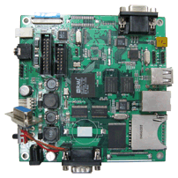
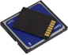

Linux Software Development Workflow
Target
Portal
Host Machine
Router
Start Console Window
BootROM
Stored in on-chipROM
Start Browser go to Portal
Preloader
Stored in flash, runs from SDRAM
Portal
Clone git Trees
kernel, U-Boot, Tool Chain
U-Boot
Stored in flash, runs from SDRAM
Develop Application
Linux Kernel
Stored in flash/network, runs from SDRAM
Build Image
(Flash/SD/QSPI)
Run Application
Binaries come pre-built in the SoC EDS

Slide 61
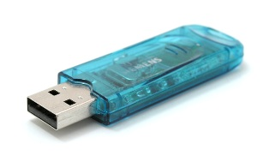
Boot Image & Flash Image
Boot Image storage location
Preloader : SD/MMC, QSPI, NAND, FPGA
U-Boot : SD/MMC, QSPI, NAND
Linux : SD/MMC, QSPI, NAND, mass storage, network via tftp, remote PC via UART
Flash Image content
1. Preloader images 2. U-Boot images 3. uImage (Linux) 4. Device Tree Blob | 5. Root file system 6. FPGA POF file 7. Applications 8. User / Application files
Note: EDS doesn’t contain tool to program SD/MMC. Use Linux or Windows tools as shown in appendix. For all other Flash devices, use HPS flash programmer
Notes:
There are lots of places on the HPS that you can store your boot code and images. IF using SD/MMC, we don’t provide a tool to program the image into those flash devices. See appendix for procedure to create

Slide 62
Altera SoC Linux: Key Features and Benefits
Feature | Benefit
Yocto | Standard Build System
Device Tree Generator | Adapts software to changing hardware
Prebuilt Binaries (EDS) | Save time to evaluate boards
Latest Stable Kernel (Kernel.org) | Latest bug fixes, features, security patches
Key Presence in Linux Community | Optimal support & design resources
Altera a designated Maintainer | Confidence in your Linux source: compatibility, longevity

Slide 63
Advanced Debug

Slide 64
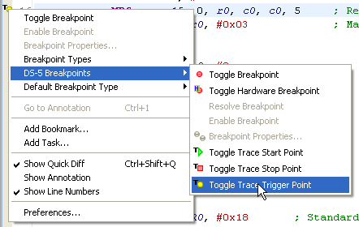
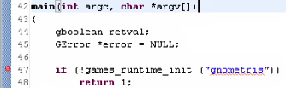

Cross-Domain Debug 1
Trigger from software world to FPGA world
SOFTWARE TRIGGER OR BREAKPOINT TRIGGER
HARDWARE TRIGGER!

Slide 65




Cross-Domain Debug 2
Trigger from FPGA world to software world
HARDWARE TRIGGER
EXECUTION STOP
SW TRACE TRIGGER!

Slide 66


Correlate HW and SW Events
Debug event trigger point set from either SignalTap™ II Logic Analyzer or DS-5 debugger
Designers can then analyze the captured trace and timestamp-correlated events
ARM® DS-5™ Toolkit
Timestamp Correlated
SignalTap II Logic Analyzer

Slide 67


Cross-Domain Debug 3
Exploiting the power of CoreSight trace
CPUs
PTM
Timestamp
STM
Timestamp
28 FPGA
Events
STM
Global timestamp unit
BREAKING THROUGH THE DEBUG BARRIER!

Slide 68
Altera and the Linux Community

Slide 69
Open Source
Code Repository
Code Repository
Founders / Admin
Community
Founders / Admin

Slide 70
Linux Distribution
Linux OS
Utilities
SW Development Tools
Kernel.org
Busybox.net
Applications
GNU.org
x.org
Linux
Distribution
Build Tools

Slide 71

Altera in the Linux Community
Altera awarded maintainership for the ‘SoC FPGA’ architecture
Kernel (arch/arm/mach-socfpga)
U-Boot (altera/socfpga_cyclone5)
Being a maintainer means
Upstream the SoC related code
Control the changes against the SoC code requested by the community
SoC FPGA is 1 of the 5 ARM platforms included in Kernel v3.7
Build one kernel that contains support for 5 ARM platforms
Open Source Community
Kernel.org, U-Boot, Yocto, Android
upstream
Maintainer
Public
Repo/git
Customers & Partners
Contributors
Notes:
Linux Kernel v3.7 will come out supporting the following 5 SoC platforms: Altera’s SoC FPGA, VExpress, Highbank, Picoxcell and Mvebu

Slide 72
Software Delivery
SoC Embedded Development Suite (EDS) will be shipped with the Altera ACDS distribution (Quartus II, etc.)
Stand alone install
The Portal site RocketBoards.org will host the SoC Linux GIT server to deliver upgrades, patches, etc.
Commercial OS vendors will distribute through their normal channels
Notes:
In software development, Git (/ɡɪt/) is a distributed revision control and source code management (SCM) system with an emphasis on speed.^{[3]} Git was initially designed and developed by Linus Torvalds for Linux kernel development; it has since been adopted by many other projects. Every Git working directory is a full-fledged repository with complete history and full revision tracking capabilities, not dependent on network access or a central server. Git is free software distributed under the terms of the GNU General Public License version 2

Slide 73



Welcome to the RocketBoards.org!
http://rocketboards.org
Silicon
Boards
Frequent Updates
Major Linux release
SDK
Mailman
Existing developer starts here
gitweb
Support
Project Repositories
Soft IP
Forum
Kernel Repository
U-Boot Repository
lists.rocketboards.org
git.rocketboards.org
Dynamic Docs
Links to partners
FOSWiki
rocketboards.org
Altera.com
Static docs
New developer starts here
Mail list server
Linux Portal
One User Experience

Slide 74



Coordinated Multi-Channel Delivery
QII
SoC EDS
.org
Altera.com
Major Releases
Binaries of Kernel, U-Boot,
Yocto, RFS
Source for
Kernel, U-Boot
Yocto, min. RFS,
GNU Toolchain
Documentation
Altera.com
Prebuilt Binaries:
Kernel ,U-Boot,
Tools, yocto, Minimal RFS
GNU Toolchain
Eclipse IDE
Libraries/APIs
SoC Tools
Sample Apps
GHRD, Drivers
Ref Designs
RocketBoards.org
Source for Kernel
U-Boot & Yocto
Updates
Patches
Public GIT
Wiki
Forum
List Server
Market place
Partner centre
Partners
OSs
BSPs
Middleware
3rd Party Tools
Support
Design Services

Slide 75
Linux Mainline Release Cycle
~Weeks: 0 ~12 Weeks ~24 Weeks
v3.8 Development
v3.9 Development
3.7.1
3.7.1
Mainline
Kernel Development
Branch
(Kernel.org)
v3.7
v3.8
v3.9
rc1
rcn
rc1
rcn
rc1
Merge Window
Stabilization
Merge Window
Stabilization
Merge Window
Community
Accepted
Code &
Altera
Upstream
New Features
No New Features
Bug Fix Only
New Features
No New Features
Bug Fix Only
New Features

Slide 76
Altera Linux Executive Summary
Altera always moves to the latest kernel version (~3 months) – See Addendum release cycle info
Altera maintains the Linux SoC architecture and upstreams to the very latest kernel (development branch)
Community focus on branch maintenance
For maintenance of older kernels/branches, customers must work with Linux partners
Common strategy (eg. TI, Freescale, etc)

Slide 77
Linux Availability Summary
Mainline kernel version – kernel.org/EDS
Development version of mainline kernel – Kernel.org
Community maintained Branches – Altera GIT server
Update and patches - Altera GIT server

Slide 78
Resources & Next Steps
Training
Altera’s Cyclone V SoC Development Kit
Links & Support
Next Steps

Slide 79


Altera SoC Dev Kit Contents
FPGA Design Software:
Quartus II Web Edition, ModelSim (Altera Starter Ed)
Golden Hardware Reference Design
Software Development Development tools (EDS):
GNU tools, Eclipse IDE, ARM DS-5 Debugger
Linux distribution & full BSP
Altera HW lib (APIs for Altera “manager” IP)
Out-of-Box Experience
Web Server (Linux) Application
Links to resources web resources
(documentation & downloads)
Board update portal
Board test system (board HW verification)
Golden HW reference design (getting started)
Web portal for one-stop Embedded SW download

Slide 80

Altera’s Dev Kit: Golden Reference Design
HPS configuration
DRAM, QSPI, SD/Card
All peripheral functions exposed at least once
Drivers
HAL
Linux
FPGA configuration
Simple Qsys “sandbox” system
First experience in ARM / FPGA integration
Getting started guide to walk them through the process integrating IP
HW simulation
Verification via system console
Verification via CPU
HW/SW hand-off
ARM A9
NEON/FPU
ARM A9
NEON/FPU
DDR/SDRAM
I$
D$
I$
D$
L2$
TMC/Trace
QSPI
USB OTG
GPIO
USB OTG
I²C
Ethernet
I²C
Ethernet
ROM
UART
SD/MMC
UART
NAND flash
RAM 64KB
SPI
SPI
FPGA mngr
CAN
DMA
CAN
TIMERS
HPS
HPS► FPGA
HPS► FPGA
Low latency
FPGA►HPS
FPGA
JTAG
Master
Memory
SYSID
PIO
PIO

Slide 81

Resources, Links & Support
SoC Altera.com Site here
Altera Dev Tools
Quartus II Design Suite – includes Qsys
Quartus II Literature, Handbook, etc.
SoC Embedded Design Suite (EDS)
Design Software & Download Center Sites
ARM Dev Tools
DS-5 Altera Edition
www.arm.com , ARM SW dev tools
Altera Forum Community: www.alteraforum.com
Altera Wiki Community: www.alterawiki.com
SoC / Linux Web Portal: http://rocketboards.org
Support info & Links
Altera’s MySupport – for submitting Service Requests – GO SIGN UP!
Altera’s Design Resources Site

